Slide 1
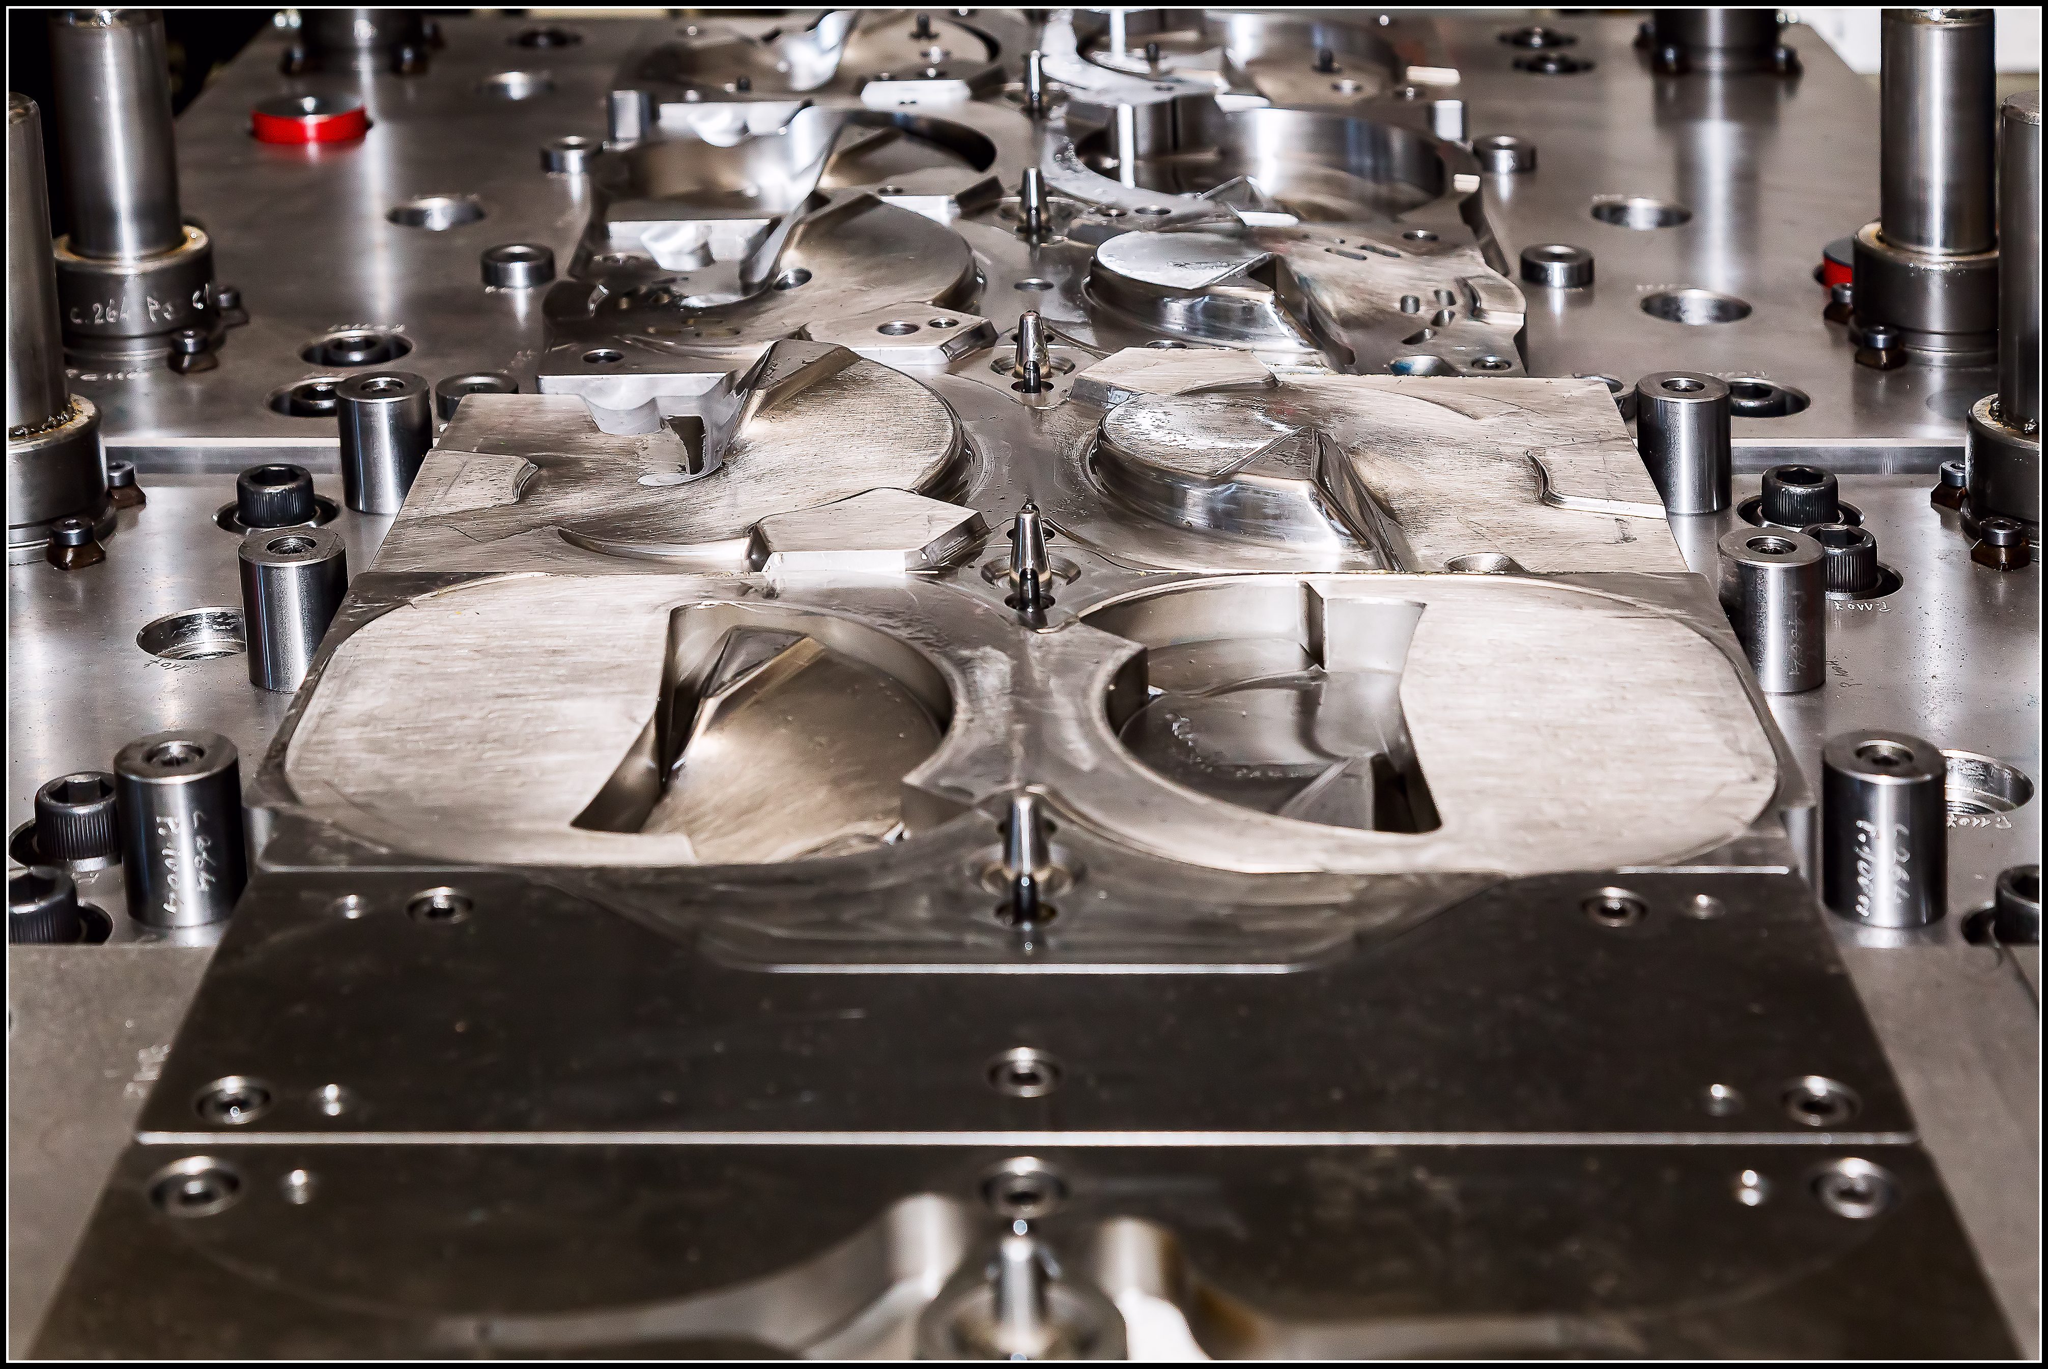

DESIGN and MANUFACTURE of DIES
For cold sheet metal forming

Slide 2
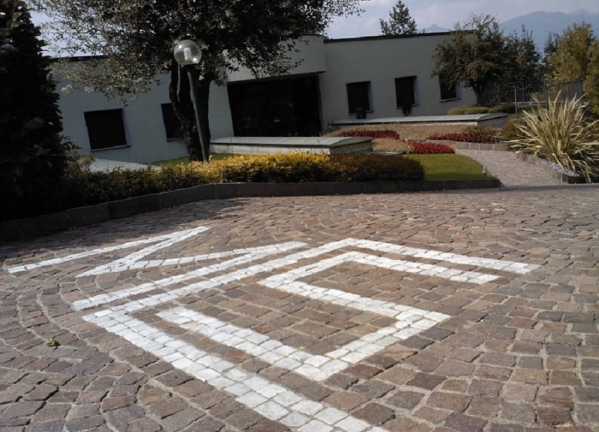
Founded in 1978
MCS Srl
It is an Italian company specializing in the design and manufacture of dies for cold sheet metal forming

Slide 3

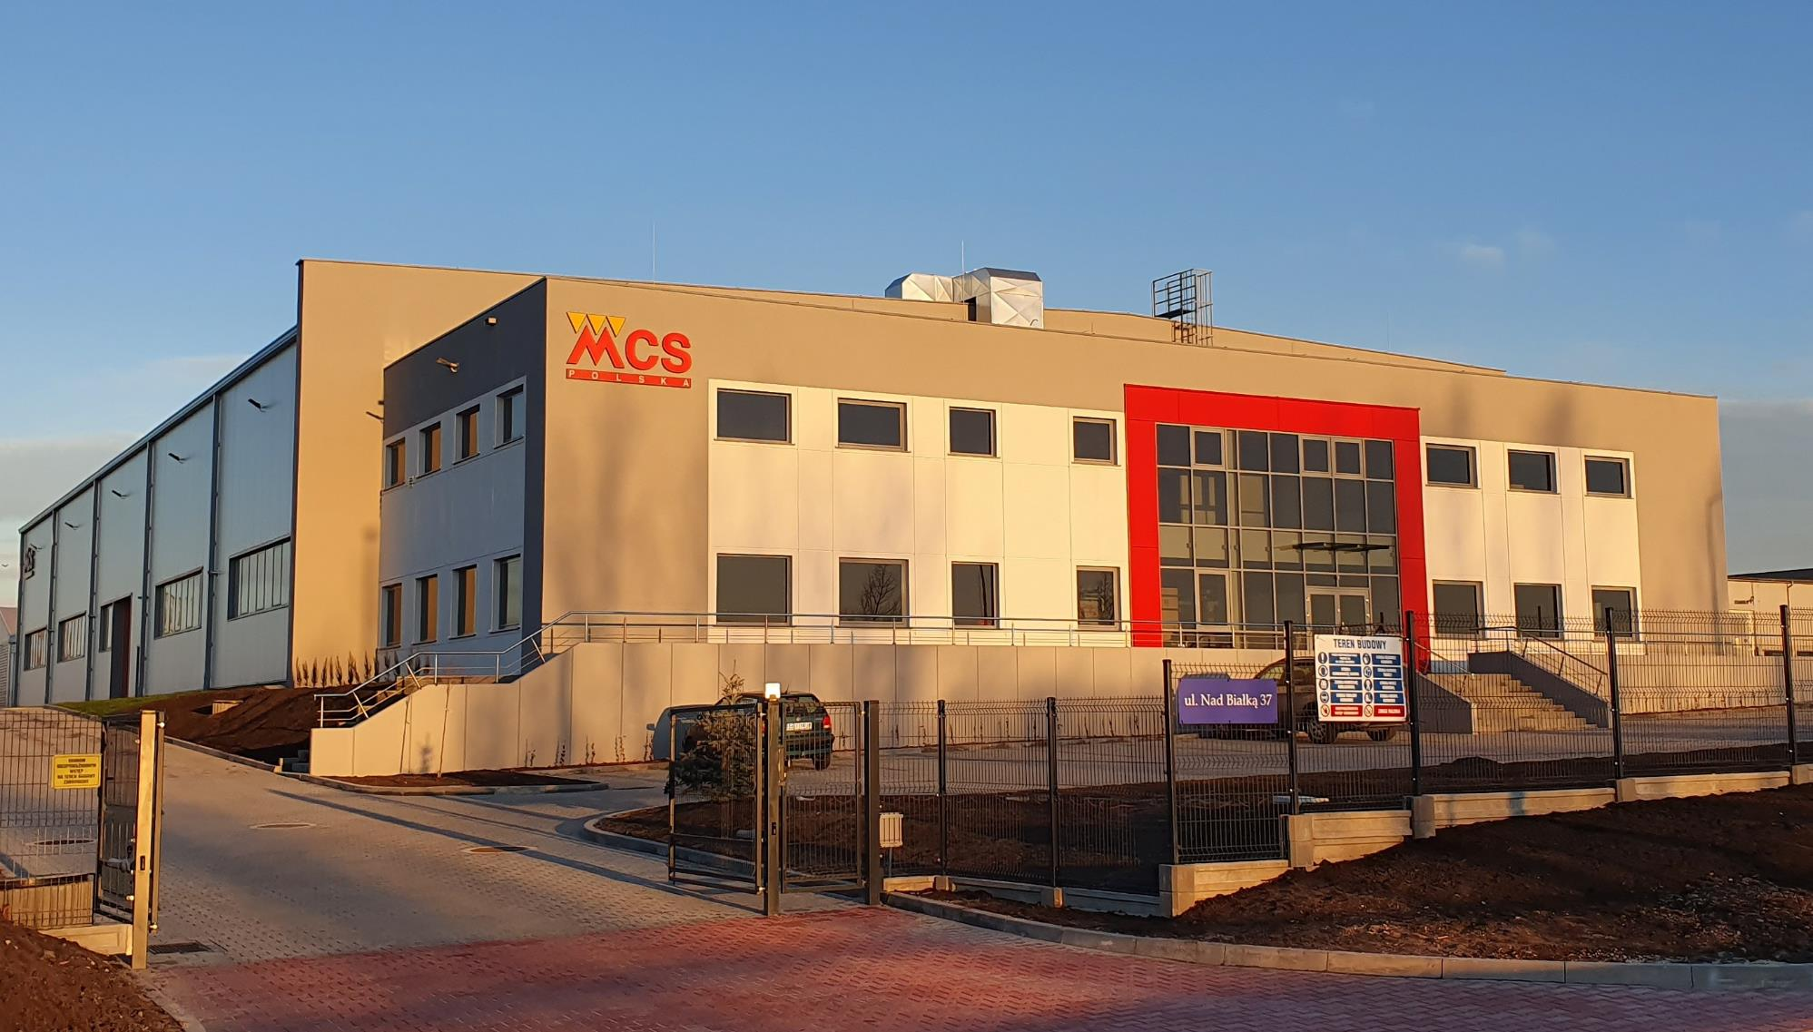
Founded in 2019
MCS Polska
We expanded into Poland with a new 4,000 sqm facility

Slide 4
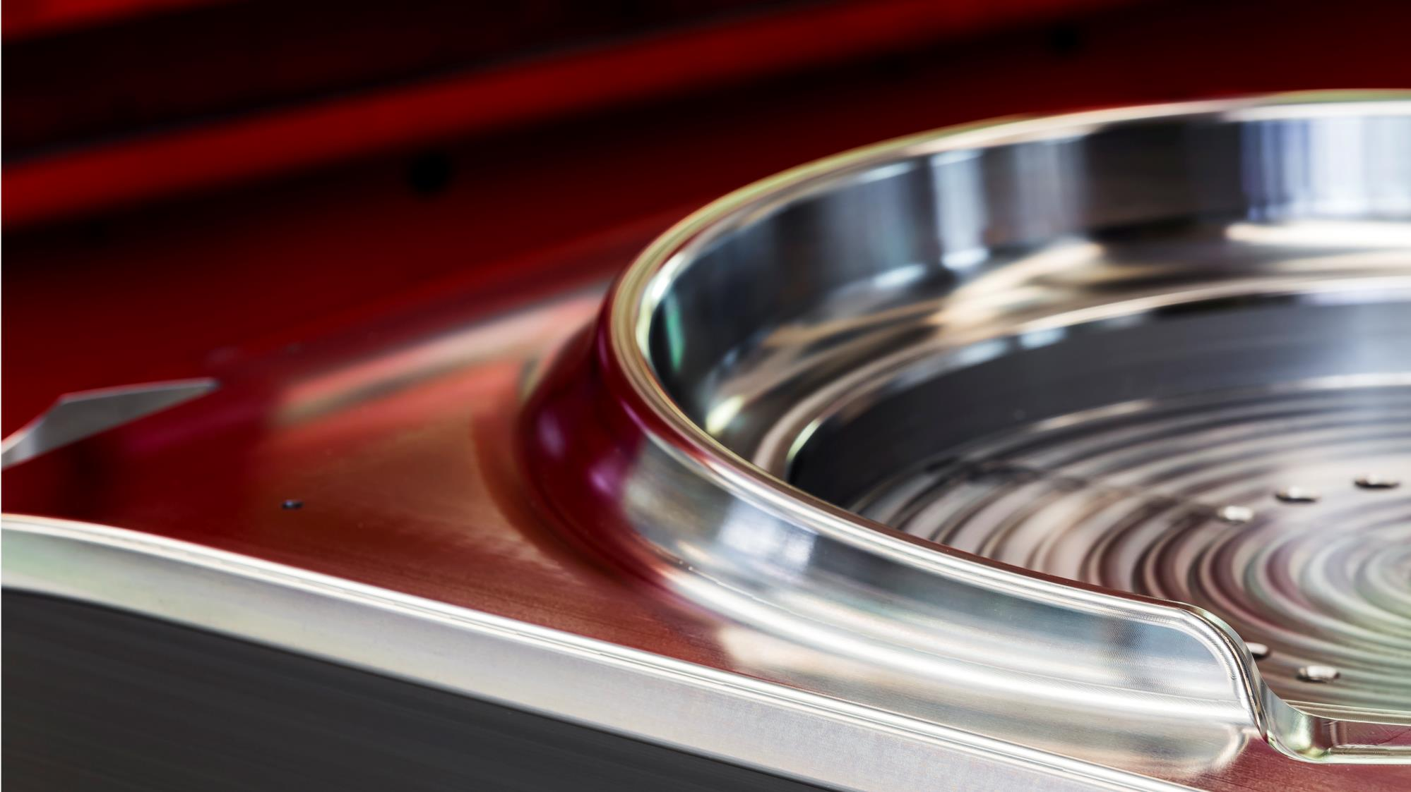
M.C.S. is an Italian company, founded in 1978, specializing in the design and manufacture of dies for cold sheet metal forming.
The production of a die follows a long process: it starts with the conception of the object, moving through a process simulation aimed at studying the stamping method. Once agreed upon with the client based on production volumes and the designated presses, the design phase begins, which M.C.S. prides itself on for its precision. The manufacturing of the equipment is then immediately undertaken, coordinated by a thorough analysis of the process.
M.C.S. also manufactures dies based on designs provided by the client, as is common in the automotive sector.
M.C.S. specializes in the construction of dies for the automotive and home appliance sectors, but any sheet metal part can be produced by our team. You design a sheet metal product, and we will manufacture it for you.
We handle single-stroke dies, progressive dies, and transfer dies, cooperating to fine-tune the part handling process.
Our production flexibility enables us to engage in automatic production of both small and large series of parts with dimensions up to 3 meters, as well as in low-volume production using manual recovery dies.
We rely on a team of highly skilled and experienced professionals in the field. One of M.C.S.'s unique characteristics is its advanced processing technology, which keeps the company at the forefront of the industry and ensures very high-quality standards.

Slide 5
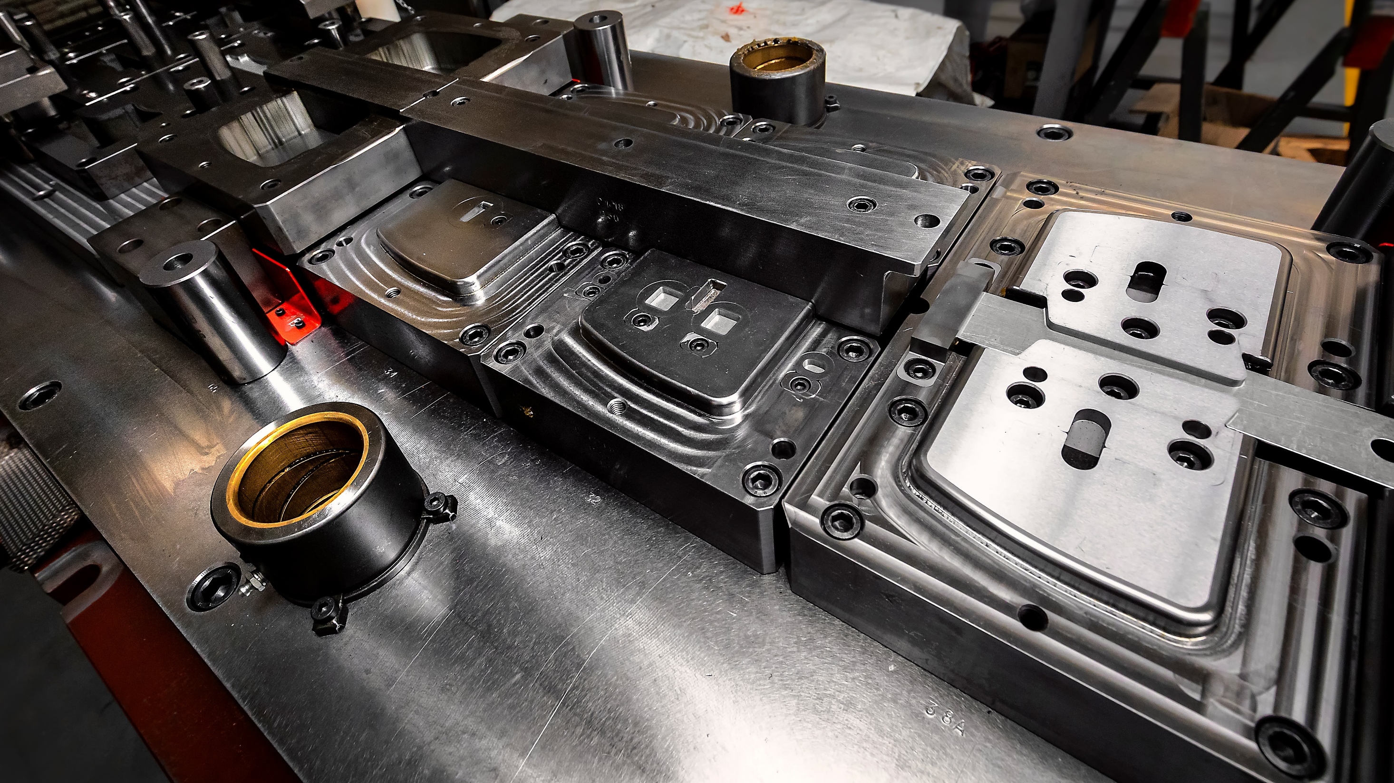
Progressive dies: Our most innovative target
Transfer dies: We aim to be a comprehensive partner, assisting the client throughout the entire process until production launch
Prototype dies: When time constraints challenge us, prototype tools allow for rapid production and/or enable refinement of the stamping methodology study
Milling and subcontracted mechanical processing: With our machinery and flexibility, we enthusiastically embrace the timing and technological challenges presented by the market. We have experience in the petrochemical valve sector, metalworking, and complex mechanical components

Slide 6
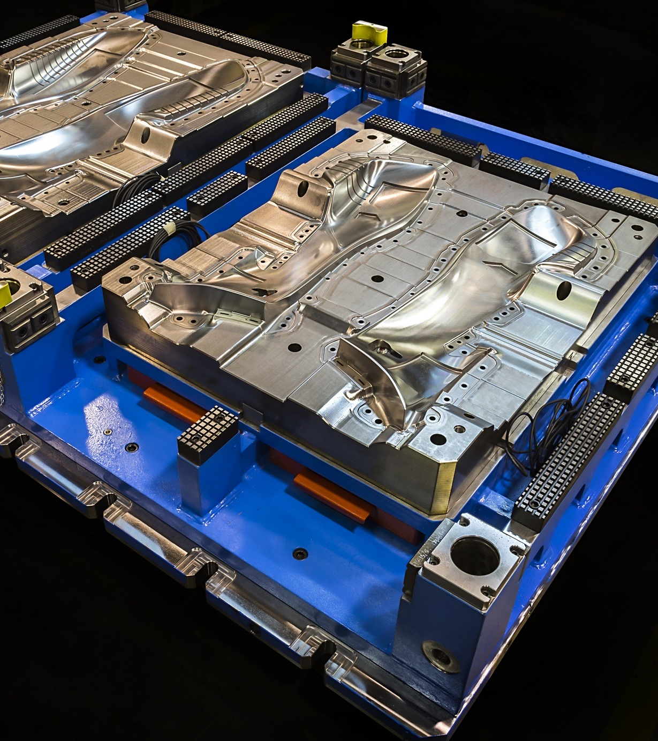
Automotive industry
Molds for chassis framework and interior body panels
Molds for reinforcement brackets, window lift guides, flanges, and mufflers
Molds for components of any type
Molds for thick sheet metal
Molds for heat shields, including those made of aluminum
Our core business

Slide 7
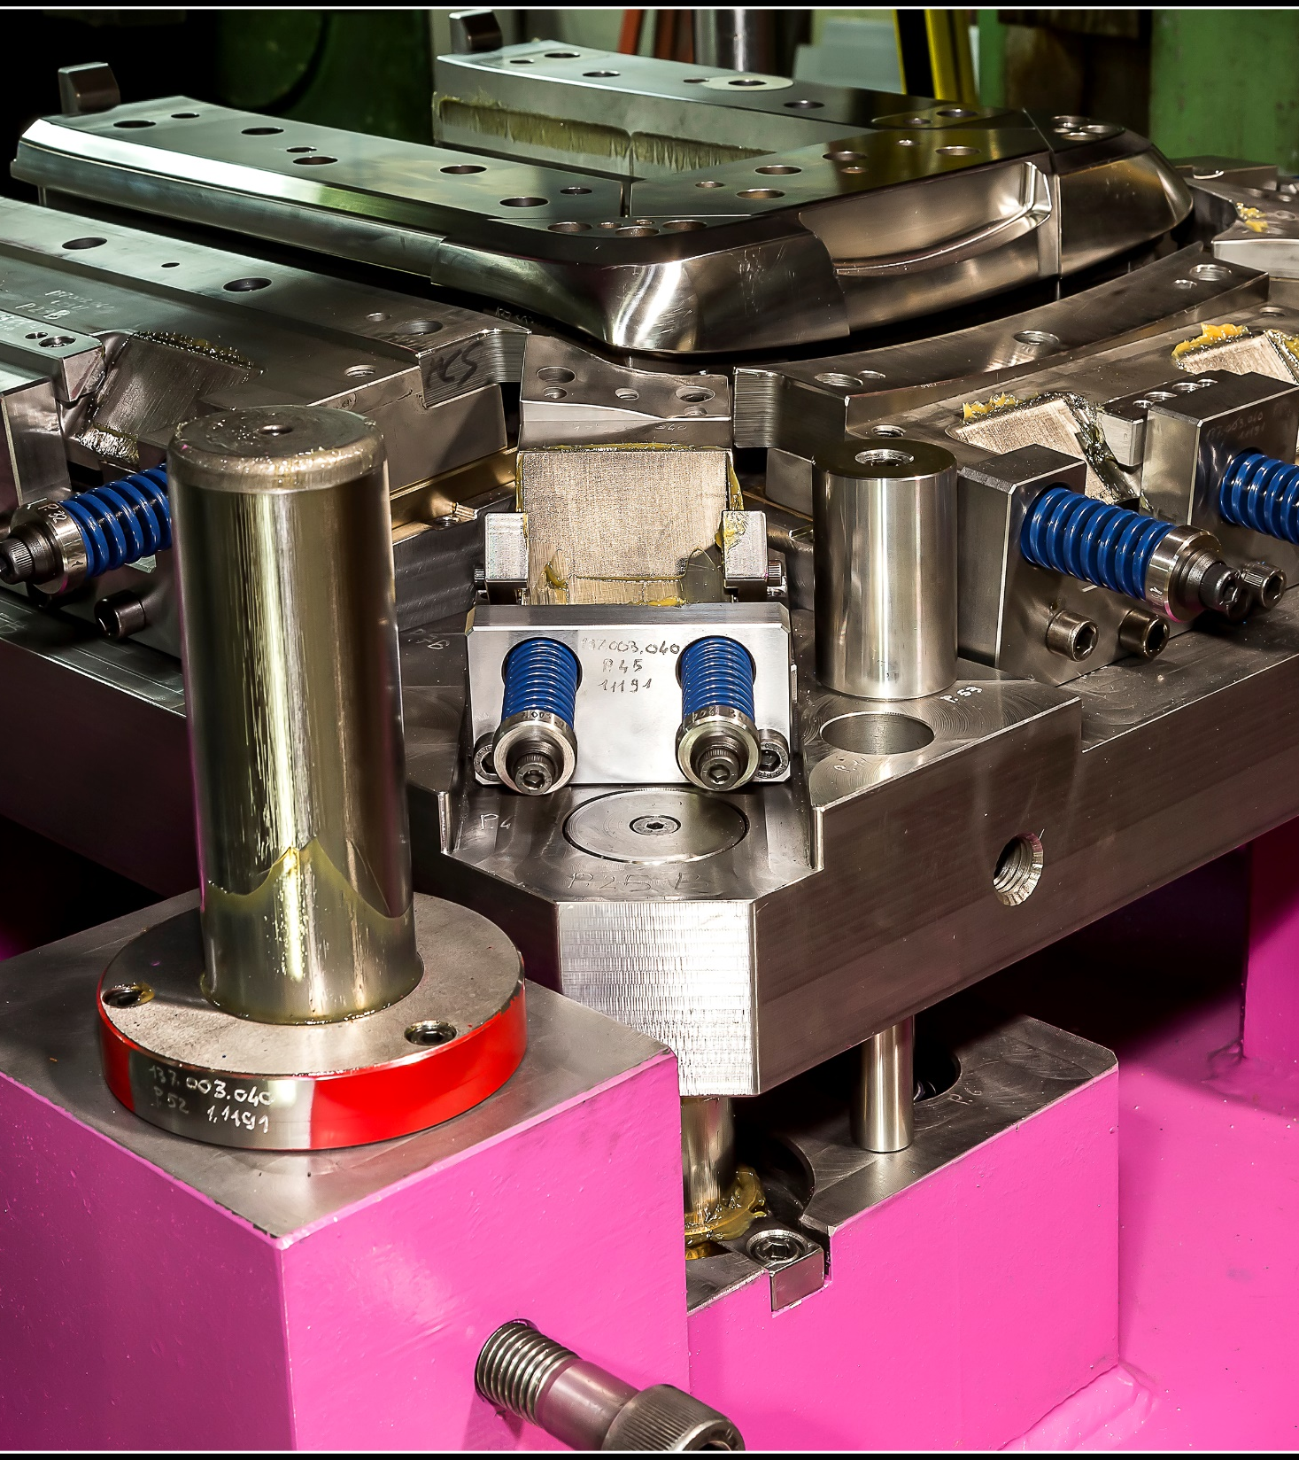
Cooktops, front panels, and kitchen structures
Panels for washing machines
Oven panels, facades, and paneling
Dishwasher tops, facades, and components
Deep drawing and scratch-resistant bending on aesthetic parts
Appliances
Our core business.

Slide 8
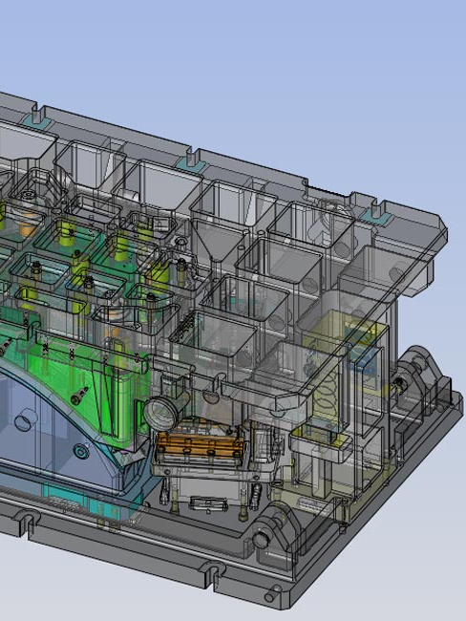
CAD CAM
Two acronyms representing one of the key aspects considered by M.C.S.
01
Methodology study
02
Simulations and pre-methodology
03
Engineering design
04
CAM

Slide 9
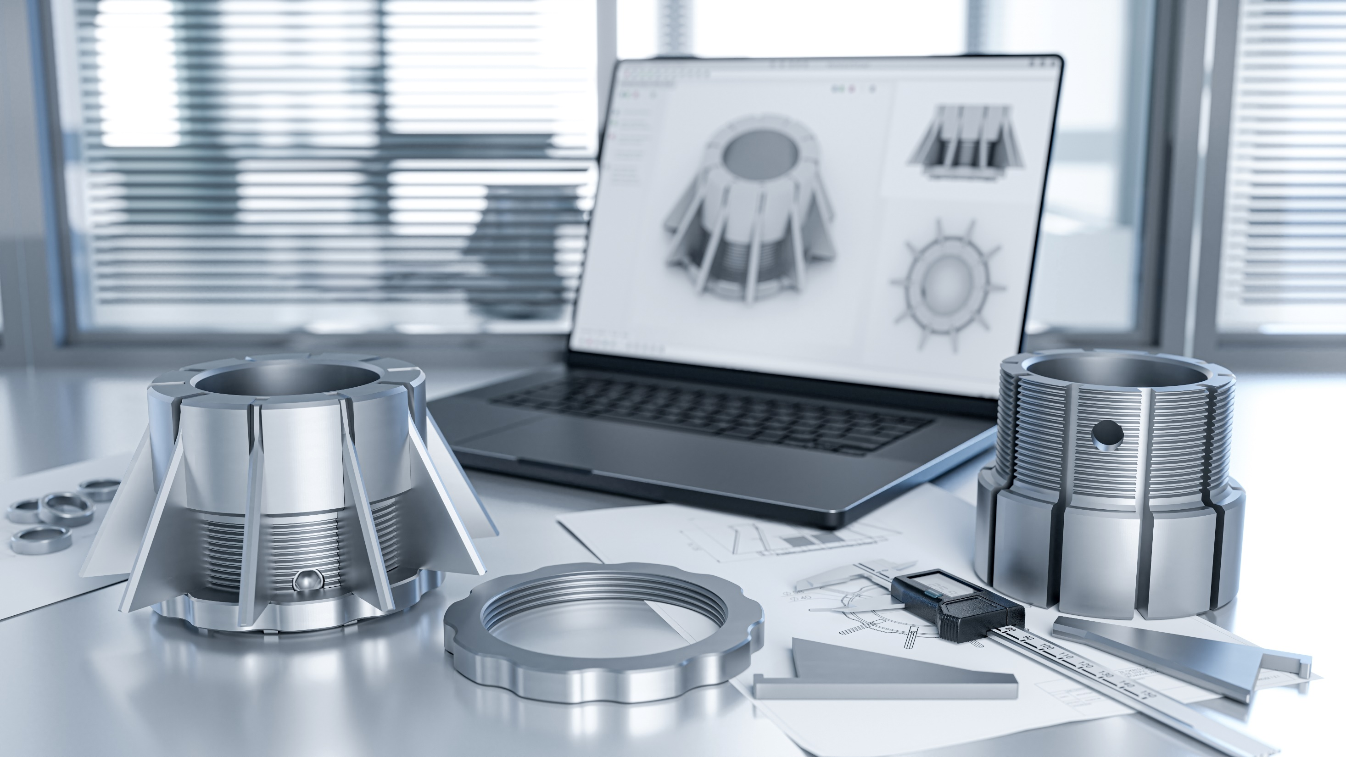
01
Every project a client submits to us is a challenge. Primarily, it is a challenge of timing but, above all, of quality. By quality, M.C.S. means the perfect balance between the client's needs and resources, production costs, quantity of parts to be produced, and the longevity of the required equipment.
For this phase, we consider the exchange of opinions essential, delving into the specific issues and unique requirements of each individual component. A collaborative table brings together experience and passion for molds with the client's production ambitions.
The fascinating world of molds always offers numerous paths to achieving the realization of a component, but finding the optimal solution represents, for M.C.S., the first important step towards a satisfactory final result
Methodology study

Slide 10

02
Simulations and pre-methodology
Often, the components you propose require software simulations or, even more frequently, practical technical tests. By creating simple tools, we either confirm that we have chosen the optimal methodology for the final component or identify a new, more effective path, either in terms of quality or cost

Slide 11
03
After careful consideration, we have a clear vision and can begin the mold design process. For nearly a decade, M.C.S. has relied on solid 3D design. This indispensable approach provides immediate clarity and understanding of the mold's functionality.
More importantly, it ensures perfect synergy between workshop operations and the technical office. We use CimatronE 13.0 as our CAD software, which has supported us from its market debut to the present day. This advanced CAD software allows us to transform ideas and experiences into 3D objects for mold and mechanical equipment projects.
Through file-sharing interfaces, the designs are managed in the workshop, minimizing paper use and utilizing the various software available in the workshop
Design

Slide 12
04
Once the design has been shared and approved by the client, the files are made available in the workshop. This is where M.C.S. has invested many years in training to achieve results that are a significant strength. Each milling or EDM station is paired with an independent workstation where qualified operators directly generate the tool paths for machining the part.
This approach differs from the usual setup where a single technical office provides programs to the workshop, and paper drawings guide any additional machining. At M.C.S., we believe that no one understands the machinery, the part being worked on, or the various variables affecting the machining strategy better than the individual operator.
The entire process is supervised through close collaboration, with dedicated personnel ensuring that every modification or variation made during the mechanical processing is accurately reflected in the original designs
CAM

Slide 13
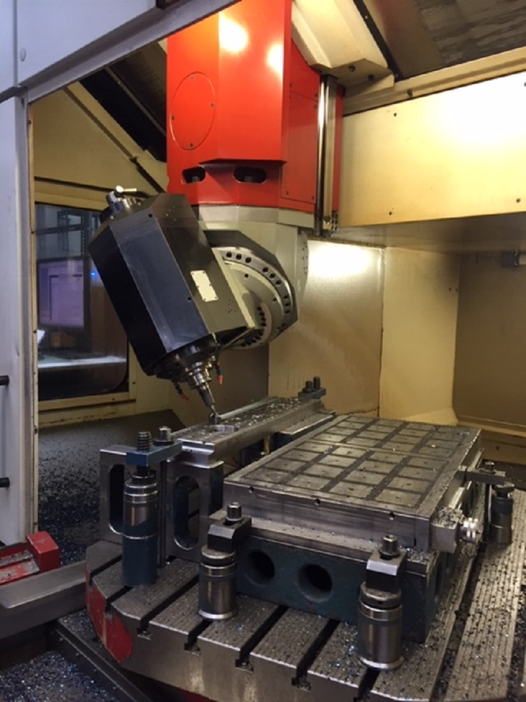
MILLING DEPARTMENT
All milling personnel possess a high level of expertise, with each individual embodying multiple professional roles. The programming of 2, 3, or 5 axes using CAM systems, selection of machining strategies, tool choices, and the actual machining process are all managed by the assigned operator.
Each operator, through the philosophies developed at M.C.S. over the years, has all the tools necessary to ensure precise machining, rigorously adhering to the component's drawings and meticulously meeting dimensional requirements.
Each milling machine is equipped with a 3D visualization station to enhance the effectiveness of the proven modern solid 3D design technology
The milling machine data is summarized as follows :
3 x 3-axis milling machines with 5-face machining capability, 3000x2200 mm (10,000 rpm)
3 x 5-axis milling machines with a working area of 1750 x 1400 mm (18,000 rpm)
1 x Okuma milling machine for machining hardened steel and superfine finishes (15,000 rpm)
8 x CNC milling machines for parts up to 1600x1200 mm

Slide 14
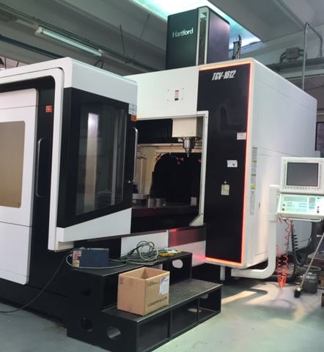
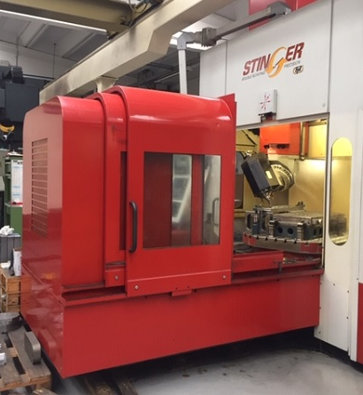

Slide 15
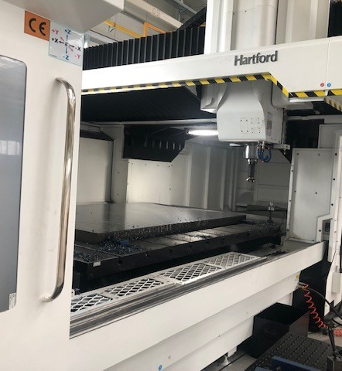
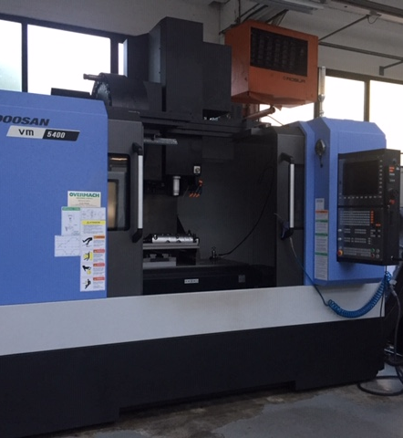

Slide 16
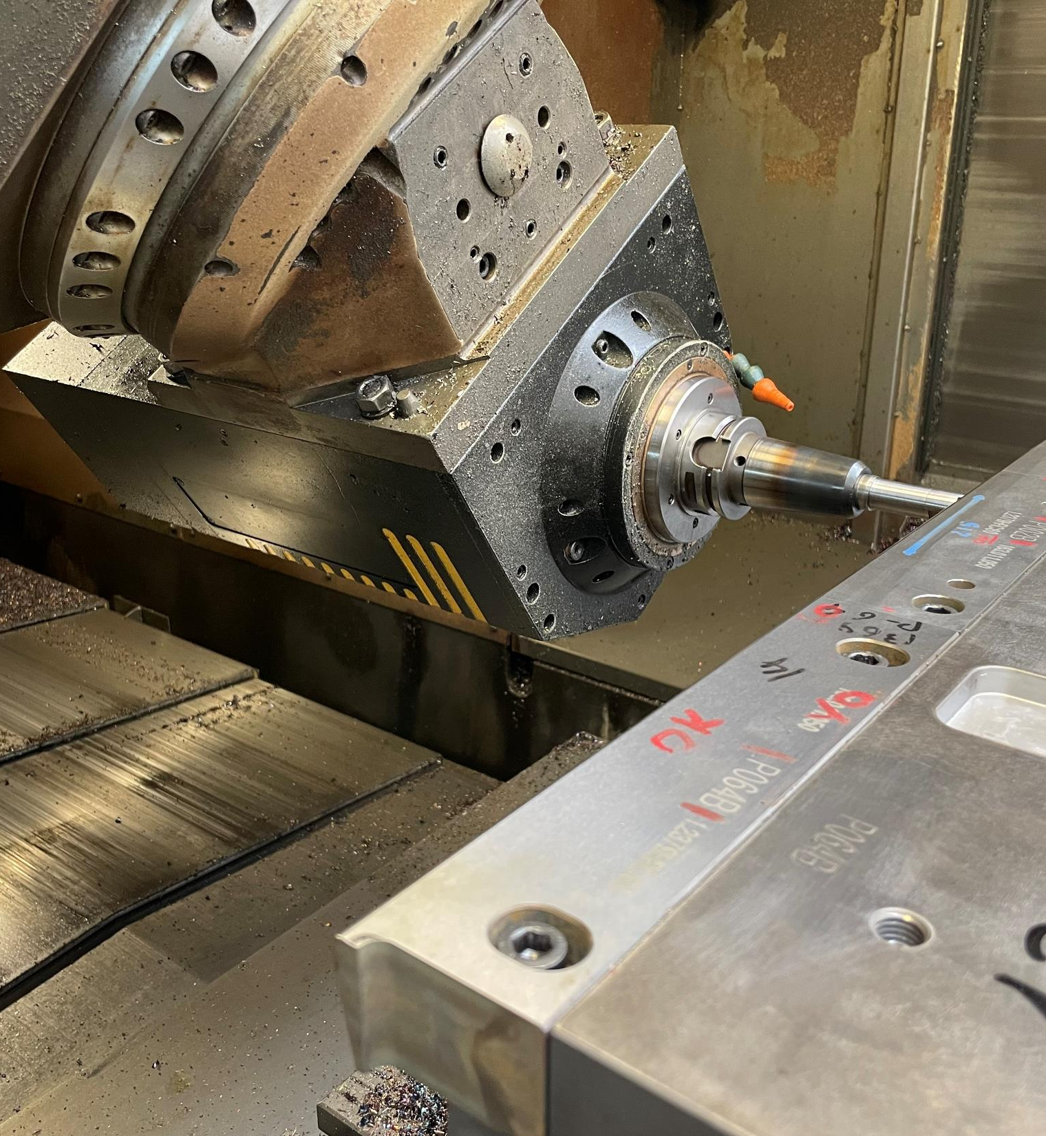
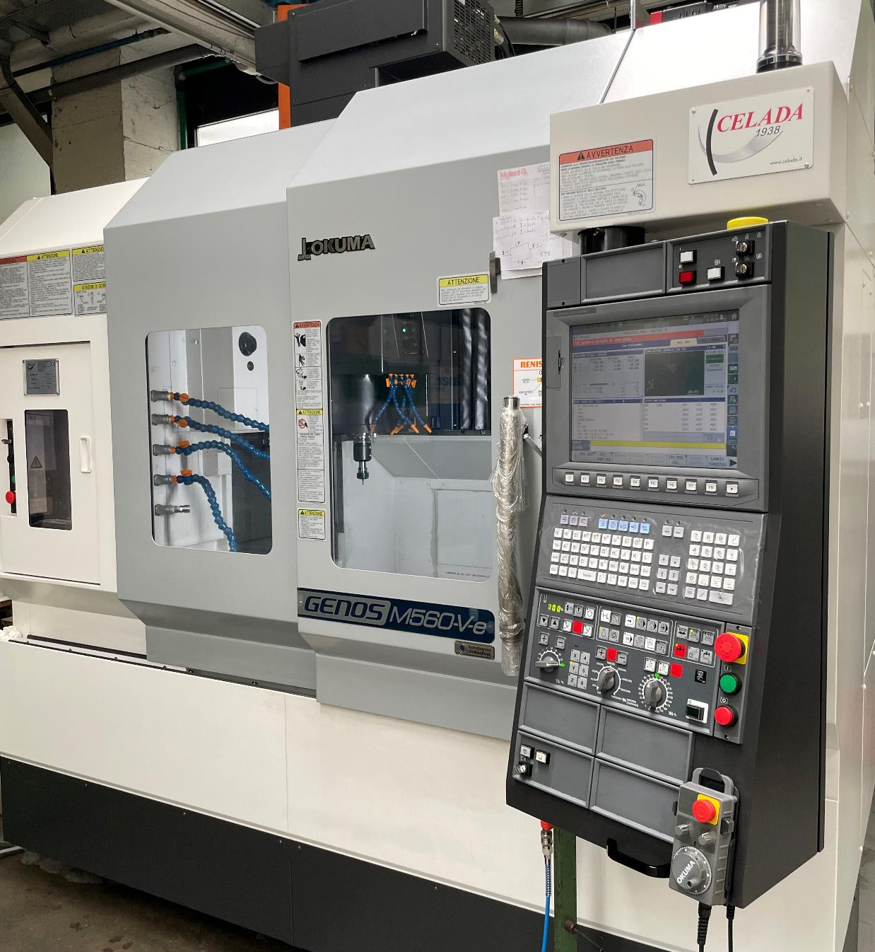

Slide 17
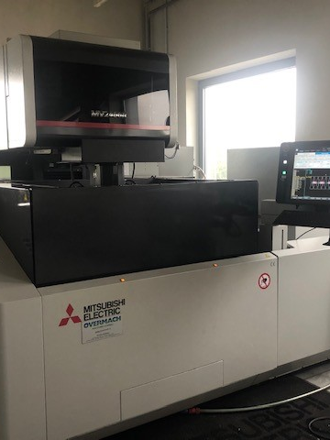
EDM Department
For over 35 years, M.C.S. has ventured into the field of wire EDM (Electrical Discharge Machining). Our chosen partners are Sodick and Mitsubishi, whose machines have led us to achieve efficiency and precision milestones that now benefit this department.
To ensure these targets, we maintain a climate-controlled area with a constant temperature, keeping thermal expansions within the limits required by a workshop that prides itself on precision.
To complete the resources needed for the production of sheet metal molds, we also utilize an ONA sinker EDM machine
The EDM data is summarized as follows:
SODICK AQ400L
SODICK AQ600L
2 MITSUBISHI MV2400R
ONA

Slide 18
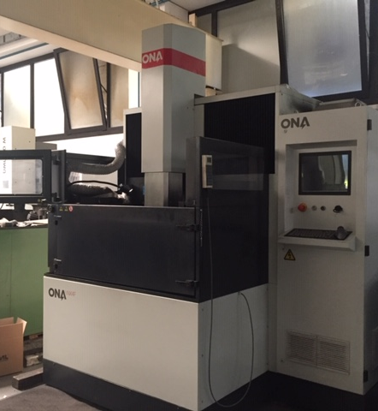
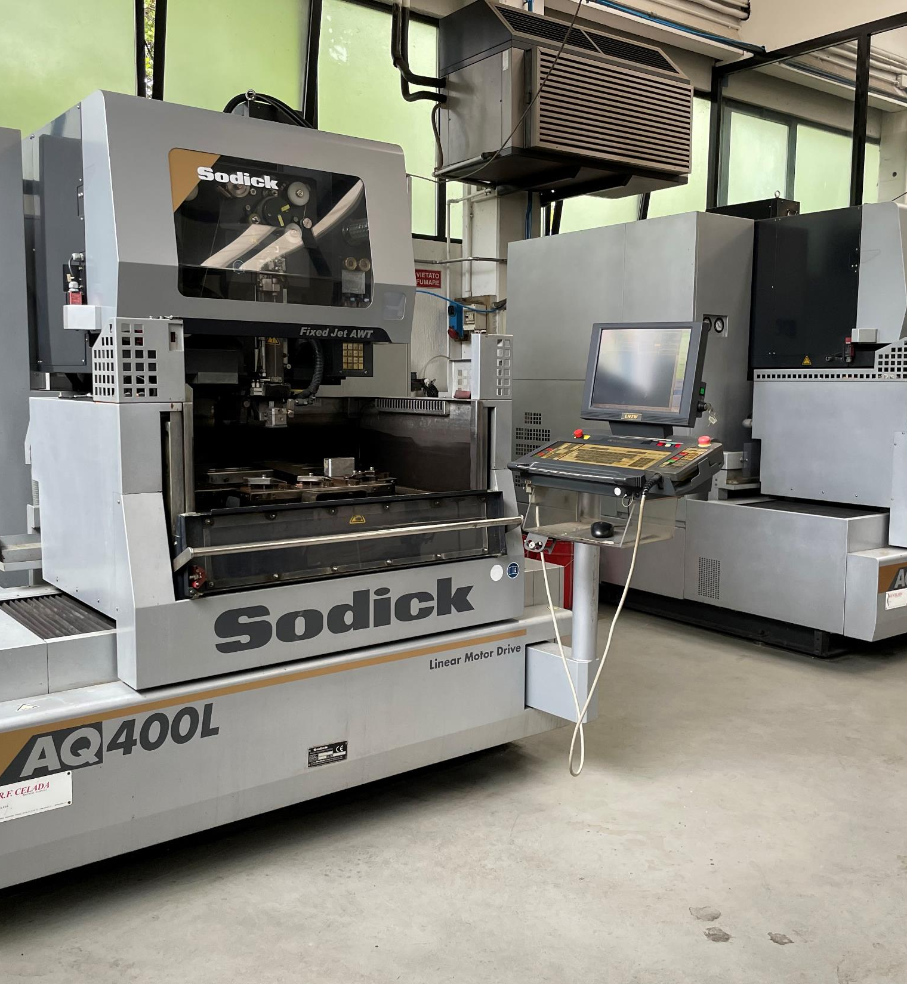

Slide 19
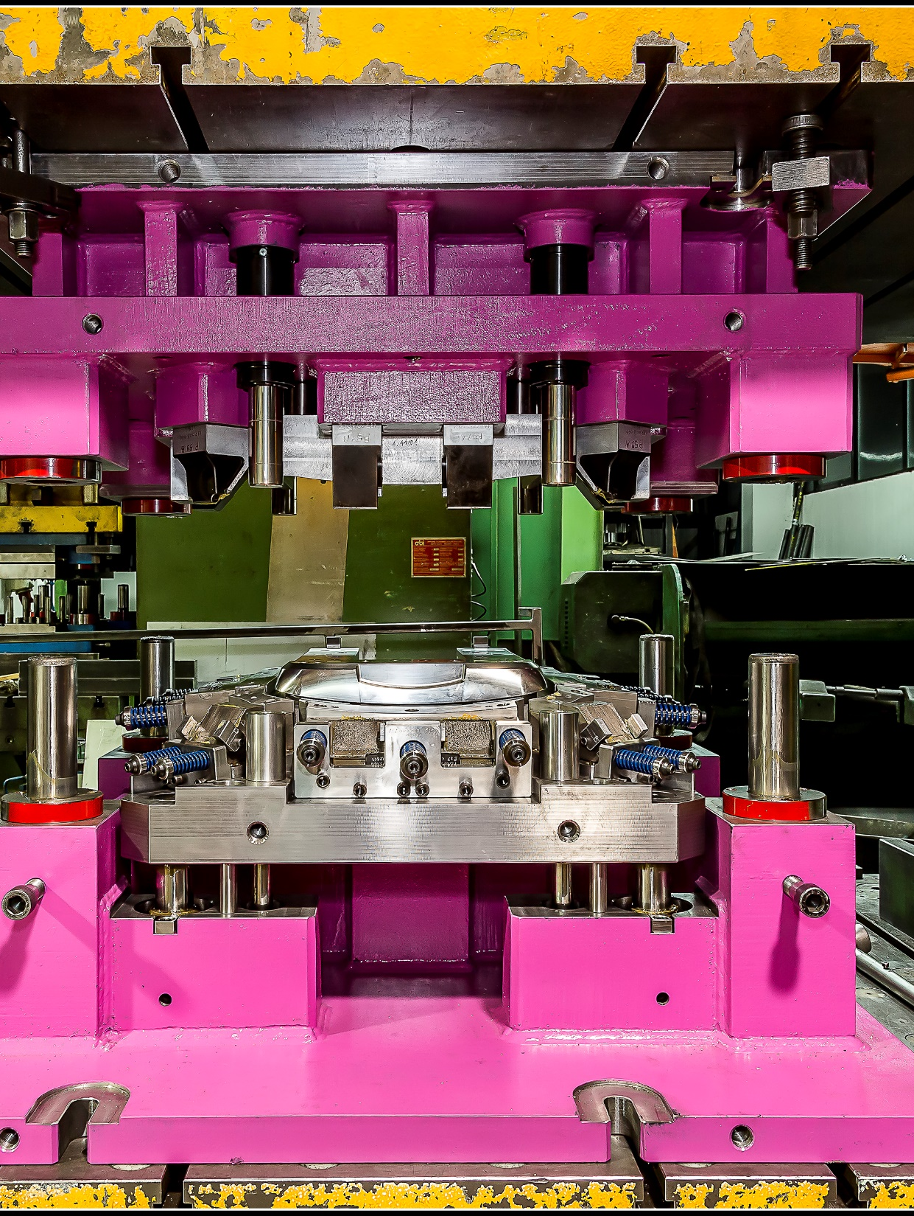
TOOLING DEPARTMENT
After all the study, design, and machining processes, we arrive at one of the most delicate and refined phases of mold construction: assembly. The M.C.S. team boasts expert toolmakers with decades of experience in assembling cold sheet metal deformation molds. Here, we verify and confirm that everything designed and machined has been executed with the proper precision and care.
Using all the tools at their disposal, our professionals skillfully assemble the molds, rigorously documenting any variation or improvement from the initial design. This attention to detail, often underestimated but consistently followed at every stage of the process at M.C.S., provides clients with key advantages. First, they can have spare parts for the mold available at any time, even years later, minimizing production downtime (it’s not uncommon for a client to request a replacement part while their mold is still in production, allowing for part substitution without halting the process).
Secondly, having a project that encompasses the entire mold construction history allows for instant evaluation of modifications requested by the final client on the finished part. Maintaining an updated design, even down to the smallest screw or manual adjustment, is a valuable resource today.
To complement the tooling department, we have a CNC lathe, a parallel lathe, a sinker EDM machine, a radial drill, drills, and all the necessary equipment to complete mold assembly

Slide 20
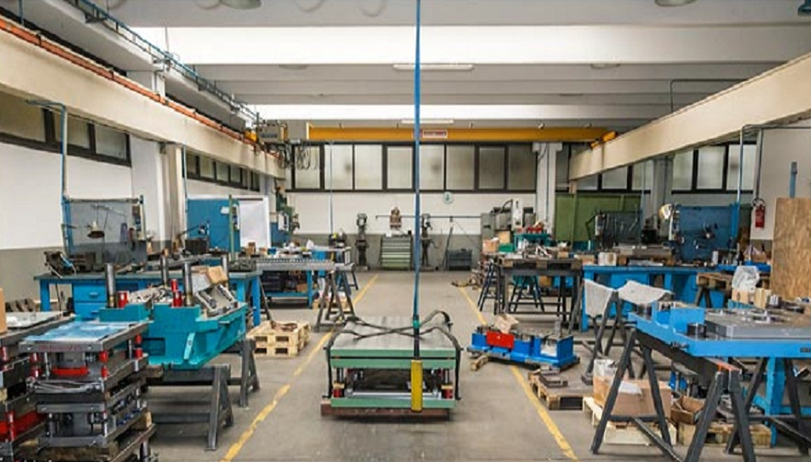

Slide 21
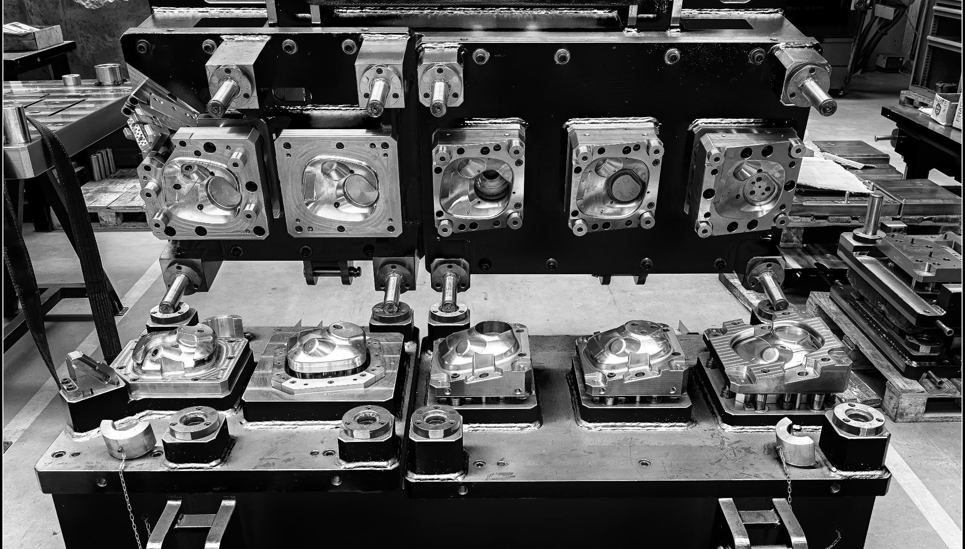

Slide 22
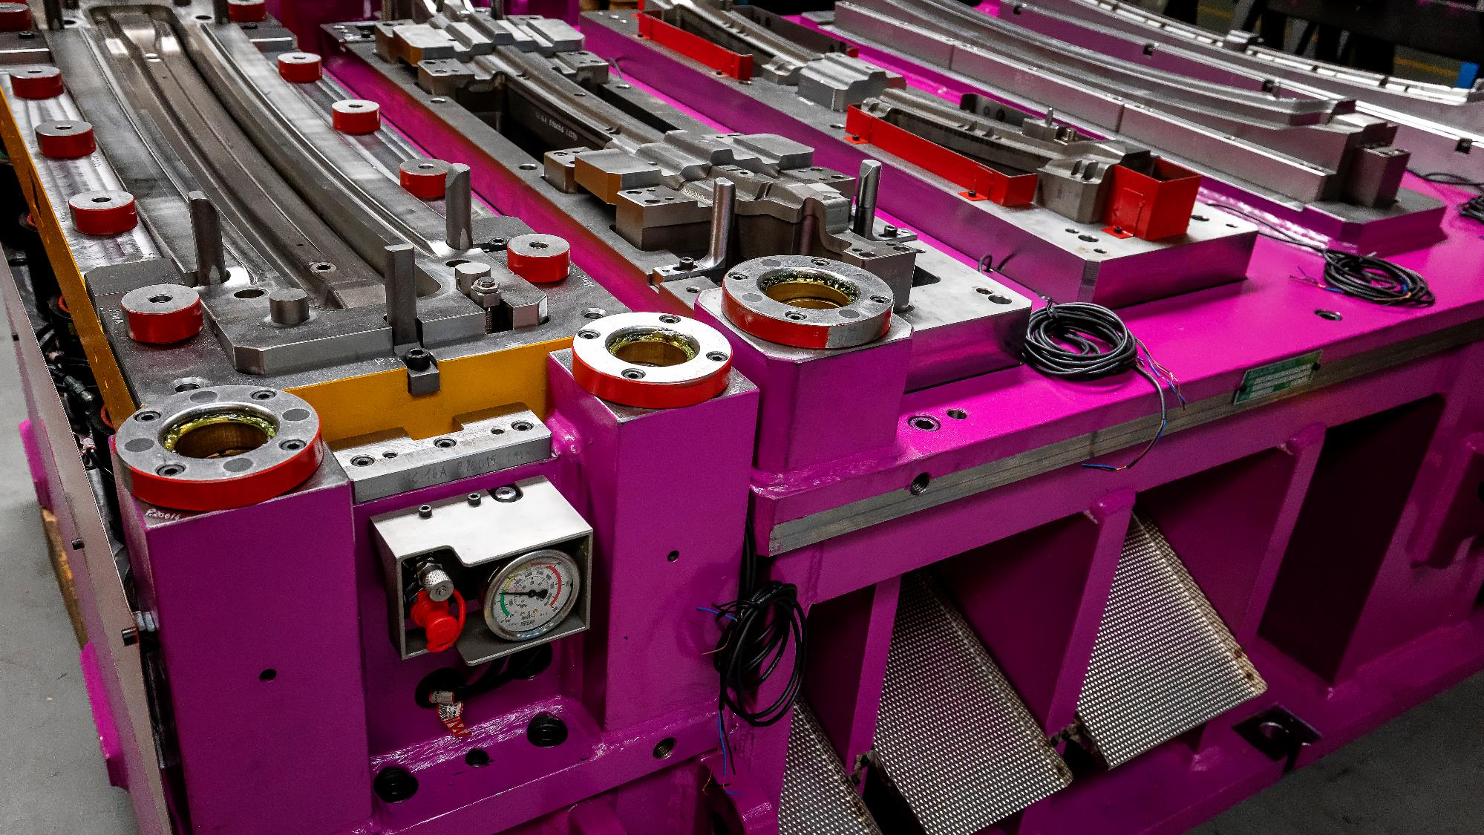

Slide 23
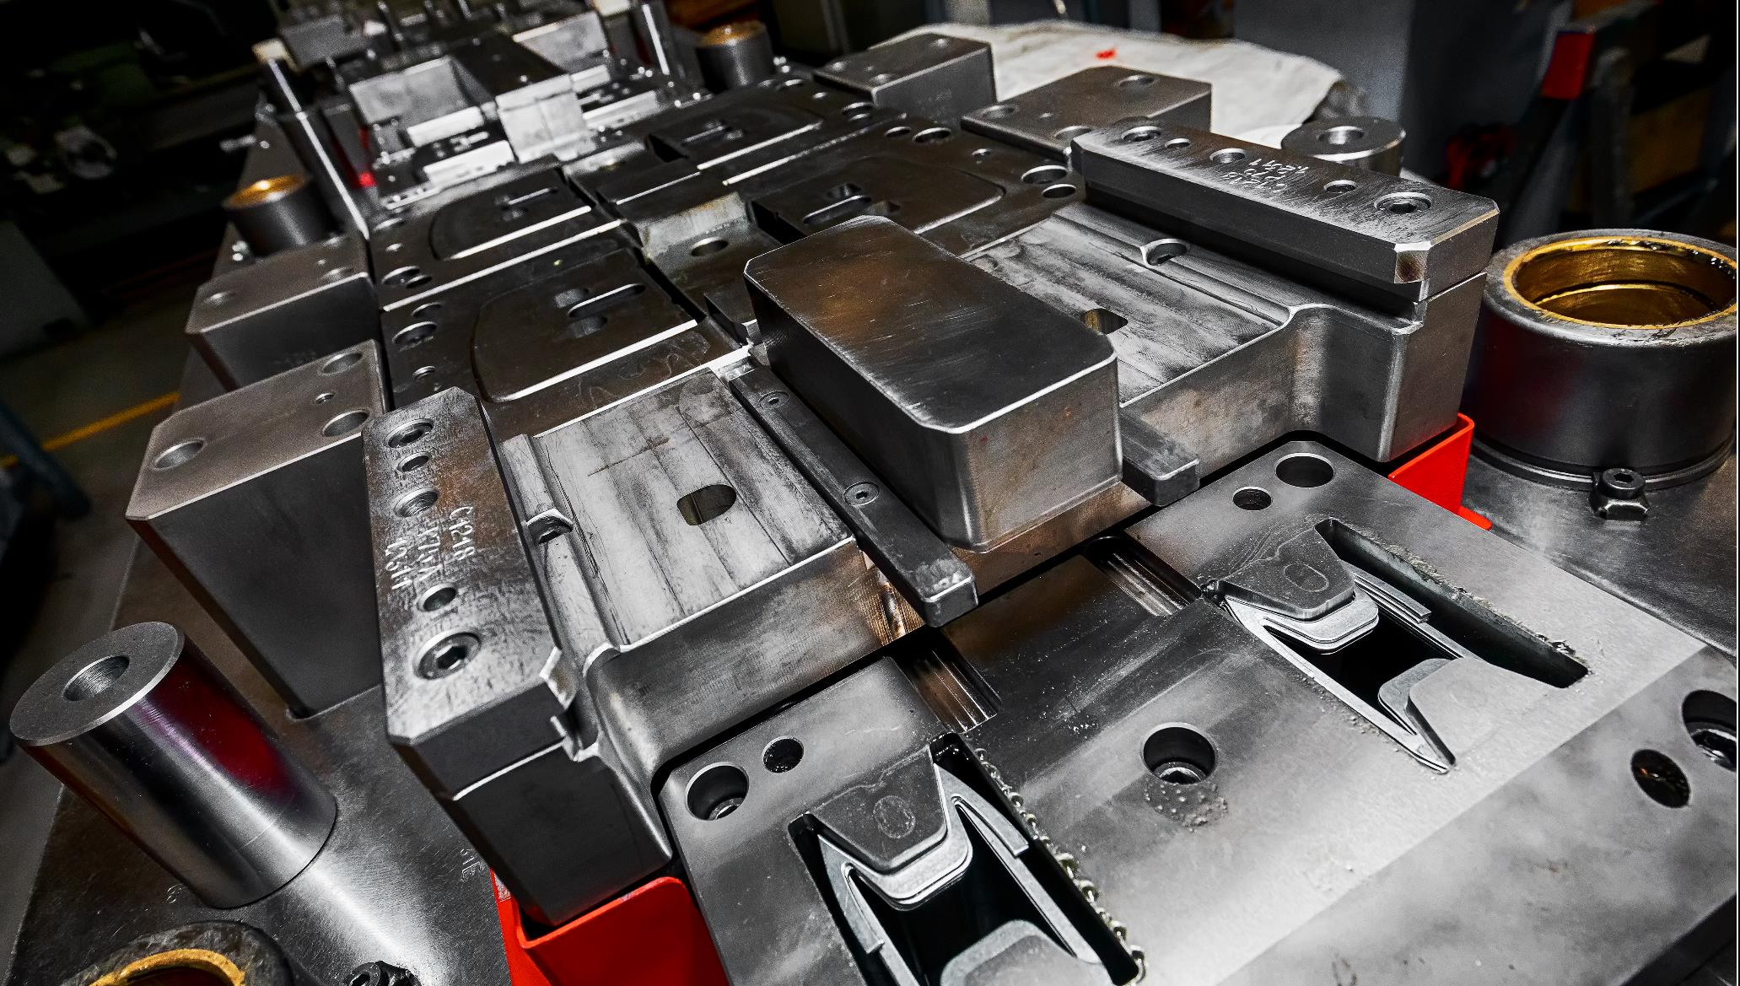

Slide 24
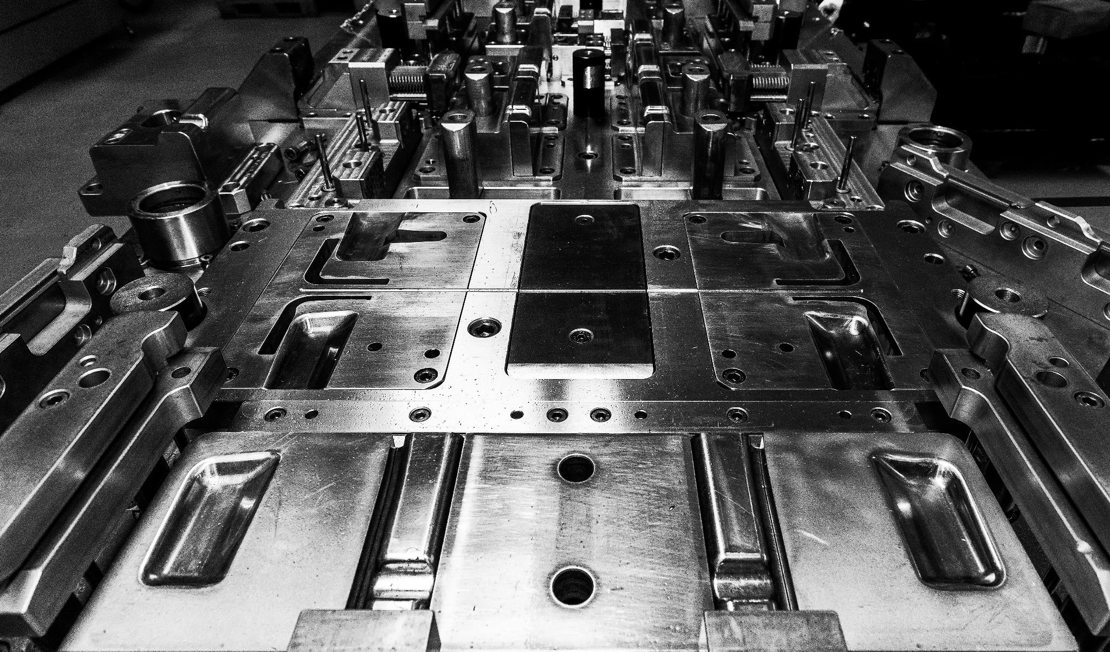

Slide 25
CONTACT US
MCS srl Via Resegone, 13 23896- Sirtori (LC) Italy
Tel.: +39 039 957326
info@mcsstampi.com
Website under costruction
MCS Polska Sp. z o.o. Ul. Nad Białką 37
43-500 Czechowice-Dziedzice
Poland
Tel.: +48 32 330 97 71
info@mcsstampi.com
Website under costruction

